Slide 1

Book of Ezra

Slide 2
Book of Ezra
This is what the Lord says: “When seventy years are completed for Babylon, I will come to you and fulfill my good promise to bring you back to this place.
Jeremiah 29:10

Slide 3
Book of Ezra
Who says of Cyrus, ‘He is my shepherd and will accomplish all that I please; he will say of Jerusalem, “Let it be rebuilt,” and of the temple, “Let its foundations be laid.”’
Isaiah 44:28

Slide 4
Book of Ezra
Now I tell you before it come, that, when it is come to pass, ye may believe that I am he.
John 13:19

Slide 5
Book of Ezra
Jews in Captivity
Communal and Religious Leadership:
Administrative and Economic Autonomy:
Treatment of Leadership:
Integration and Social Standing:
Limits on Authority:

Slide 6
Book of Ezra
Kings of Persia
Cyrus the Great (Cyrus II) (r. c. 559–530 BCE)
Cambyses II (r. 530–522 BCE)
Smerdis/Bardiya (r. 522 BCE)
Darius I (the Great) (r. 522–486 BCE)
Xerxes I (r. 486–465 BCE)
Artaxerxes I (r. 465–424 BCE)
Xerxes II (r. 424 BCE) & Sogdianus (r. 424–423 BCE)
Darius II (r. 424–404 BCE)
Artaxerxes II (Mnemon) (r. 404–359 BCE)

Slide 7
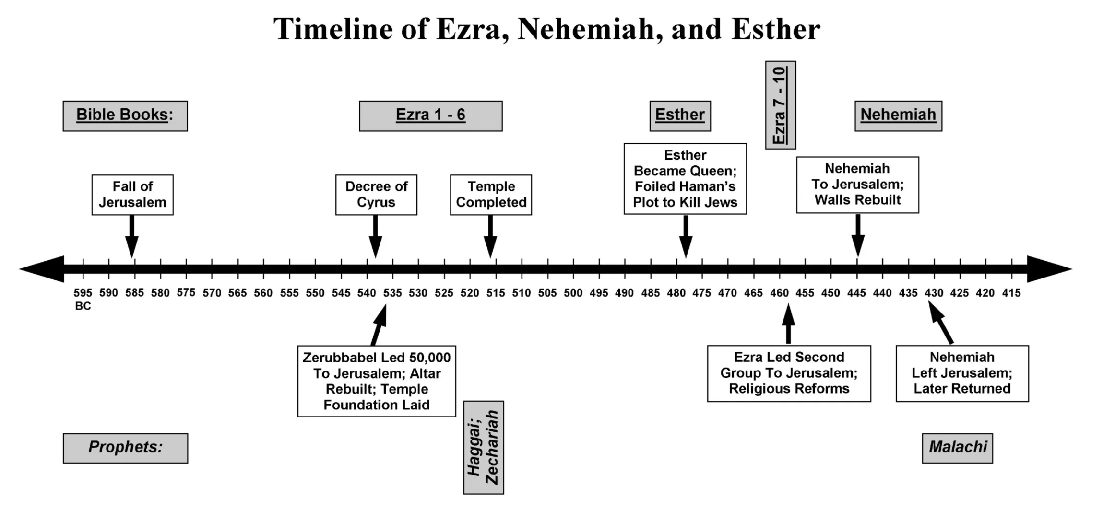
Book of Ezra
Kings of Persia

