Slide 1

Afterward, as you know, when he wanted to inherit this blessing, he was rejected. Even though he sought the blessing with tears, he could not change what he had done.
Hebrews 12:17 NIV

Slide 2
7 Do not be deceived: God cannot be mocked. A man reaps what he sows. 8 Whoever sows to please their flesh, from the flesh will reap destruction; whoever sows to please the Spirit, from the Spirit will reap eternal life.
Galatians 6:7-8 NIV

Slide 3
See to it that no one falls short of the grace of God and that no bitter root grows up to cause trouble and defile many.
Hebrews 12:15 NIV

Slide 4
He then added, “Very truly I tell you, you will see ‘heaven open, and the angels of God ascending and descending on’ the Son of Man.”
John 1:51 NIV

Slide 5
I am with you and will watch over you wherever you go, and I will bring you back to this land. I will not leave you until I have done what I have promised you.”
Genesis 28:15 NIV

Slide 6
For I know the plans I have for you,” declares the LORD, “plans to prosper you and not to harm you, plans to give you hope and a future.
Jeremiah 29:11 NIV

Slide 7
7 Though I walk in the midst of trouble,
you preserve my life.
You stretch out your hand against the anger of my foes;
with your right hand you save me.
8 The Lord will vindicate me;
your love, Lord, endures forever—
do not abandon the works of your hands.
Psalm 138:7-8 NIV

Slide 8
However, as it is written:
“What no eye has seen,
what no ear has heard,
and what no human mind has conceived”—
the things God has prepared for those who love him—
1 Corinthians 2:9 NIV

Slide 9
7 Do not be deceived: God cannot be mocked. A man reaps what he sows. 8 Whoever sows to please their flesh, from the flesh will reap destruction; whoever sows to please the Spirit, from the Spirit will reap eternal life.
Galatians 6:7-8 NIV

Slide 10
Let a righteous man strike me—that is a kindness;
let him rebuke me—that is oil on my head.
My head will not refuse it,
for my prayer will still be against the deeds of evildoers.
Psalm 141:4 NIV

Slide 11

Jacob Review
Genesis 25 – Birth of Jacob
-Promise from God
-Jacob obtained birthright from Esau
Genesis 26-27– Jacob takes Esau's blessing from Isaac.
-Esau found out and wanted to kill Jacob
-Rebekah set up Jacob's departure

Slide 12
Jacob Review
Genesis 28- Jacob left for Laban's house
-Jacob's dream from God – Promise for descendants will be "like dust of the earth"
Genesis 29- Jacob arrived – met Rachel and Laban – 7 year service – deceived by Laban to marry Leah.
-Birth of Reuben, Simeon, Levi, and Judah

Slide 13
Reuben – Behold a son
Simeon – He has heard
Levi – Be joined
Judah – To praise or give thanks
Dan – God is Judge
Naphtali – My wrestling or struggle
Gad – Fortune, luck or happiness
Asher – Happy or Blessed

Slide 14
Issachar – For reward or hire
Zebulun – Gift from God, honored, exalted house
Dinah – Judged, Judgment, Vindicated
Joseph – He will add, or increase
Benjamin (Ben-Oni)– Son of my right hand (Son of my trouble)

Slide 15
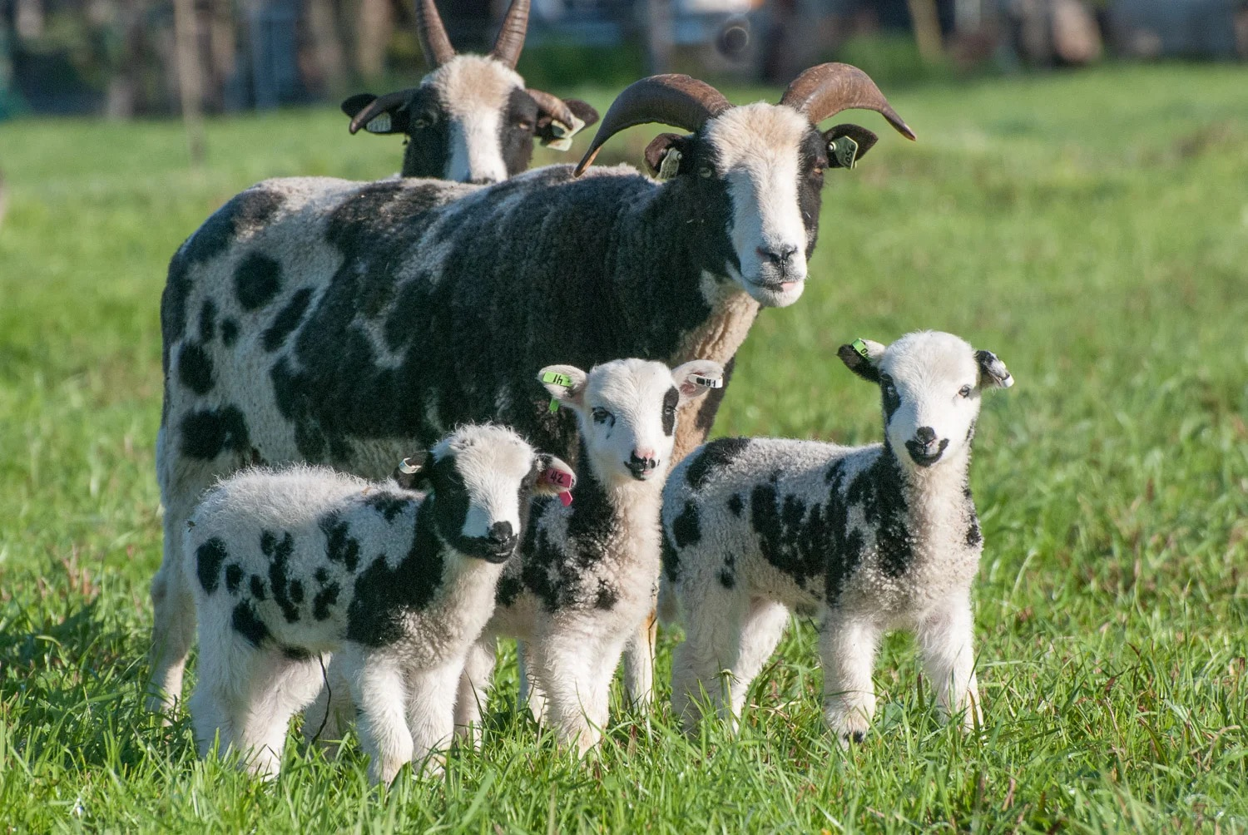

Slide 16

Do not forget to show hospitality to strangers, for by so doing some people have shown hospitality to angels without knowing it.
Hebrews 13:2 NIV

Slide 17
For he will command his angels concerning you
to guard you in all your ways;
Psalms 91:11 NIV

Slide 18
5 Trust in the Lord with all your heart
and lean not on your own understanding;
6 in all your ways submit to him,
and he will make your paths straight.
Proverbs 3:5-6 NIV

